Slide 1
Costly Misclassification
What we can do to fix it!

Slide 2
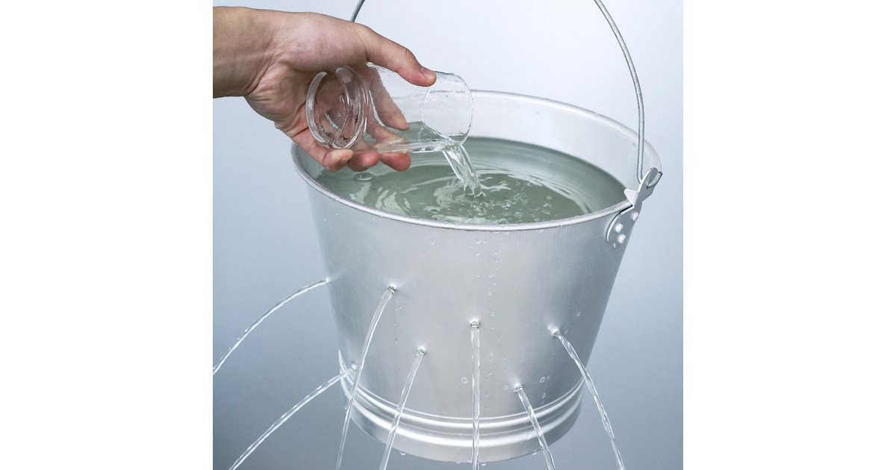
Where Do The Costs Accrue?
We’re spending money we don’t need to be!
Misdiagnosing a patient can sometimes prove to be very costly. We can avoid some of these costs by allowing the model to 'abstain' from making a prediction, whenever it is uncertain about the diagnosis for a patient.
If the hospital abstains, it will have to send the patient to an endocrinologist, which would incur additional cost, but not as much as a misclassification!
It pays not to be wrong!

